Slide 1

Marketing Plan
May 2020

Slide 2

What is Sprout?
Focus on social change
Vision:
Transform how we grow, share, and consume our food.
Mission:
Create a mutually beneficial relationship between local farmers, customers, and the environment through fair exchange and shared farm experience.

Slide 3
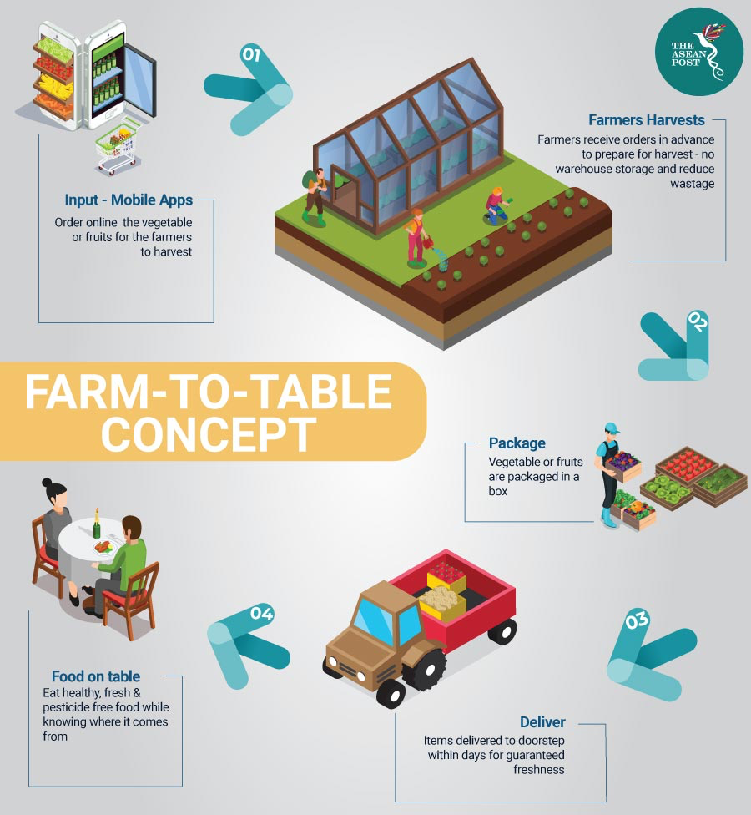


Slide 4
Qualitative Market Research
CUSTOMERS
SUPPLIERS
COMPETITORS
20% of Spain’s total gross domestic product (GDP) comes from Catalonia.
Previous research on organic foods market show favorable attitudes toward organic foods in age groups of 18-25 and 26-35 years.
Amount of operators in Catalonia
Activity Type | Rank
Primary | 4th
Secondary | 1st
Tertiary | 1st
Services provided:
Seasonal products
Food baskets
Different sizes
Limited changes
Home delivery
Weekly
Charges for delivery
Contact with suppliers:
Home Delivery
Availability in supermarkets

Slide 5
Quantitative Market Research
Key Findings:
Shopping Habit:
85% get their groceries from supermarkets, but 70% would consider buying online.
59% buys groceries once a week
Respondents use more recyclable materials (4.2/5)
Organic Food:
Respondents are less likely to go out of their way to get organic food, but they will consume more if they are more available (3.9/5)
Interest in Farm Visit:
Female 21-25 age group (7.2/10)
Female 26-30 age group (7.6/10)

Slide 6
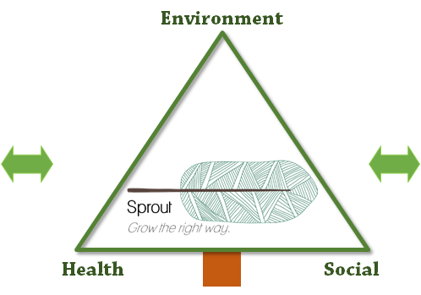


Strategic Marketing: Sprout Experience
Farms in Barcelona
Many farms within 150km
Good distribution channels
Variety of products
Customers
Age 18-25: Care for health , environment and experience
Age 25-35: Bigger tickets
Prone to use online channel.
😀 Social, environmental and healthy brand → Sprout
😀 Start as a niche and grow the right way with customers and farmers

Slide 7
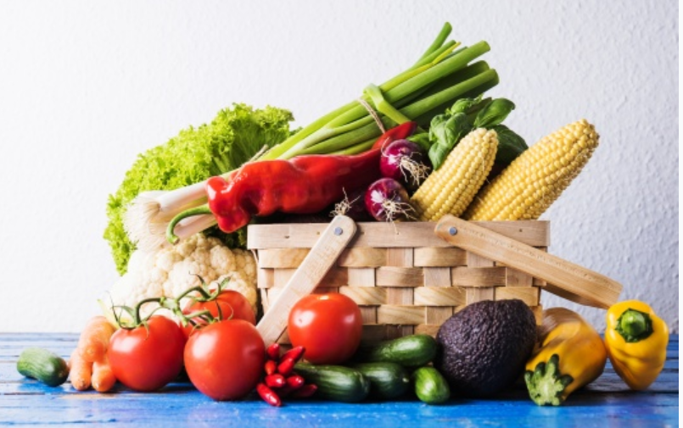
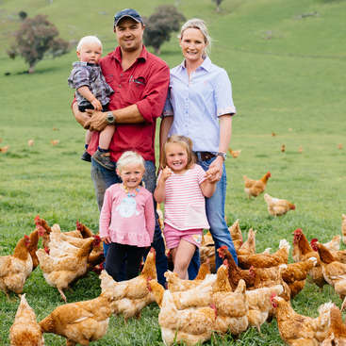
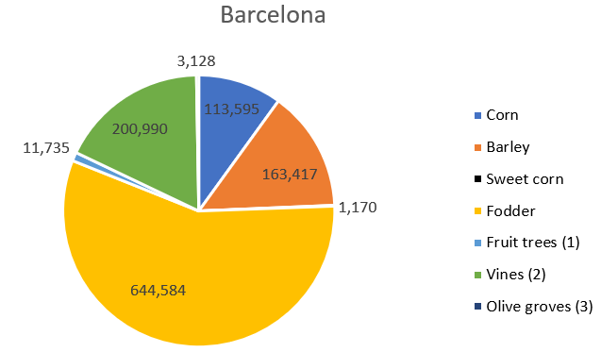
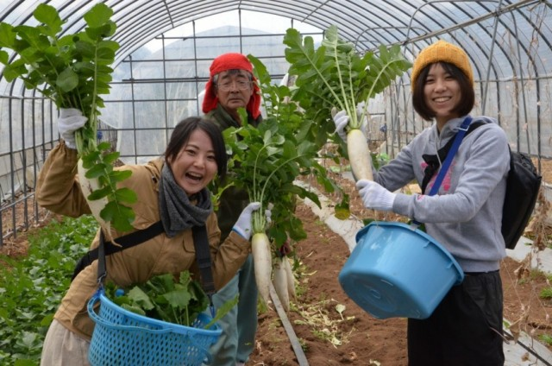
Products
Baskets of fresh products
Farming experience

Slide 8

Place
Type of distribution: Indirect Distribution & Selective Distribution
3 possible distribution channels:
On our Website/Mobile app
On the “open-day”
Flea Market every weekend
Delivery once a week
Have agreements with drivers who already had a truck
No warehouse

Slide 9
Price
Strategy: Commission-based + Subscription-based
Price Range
Free
Place Order
Free delivery on purchases over 30€
PRODUCT | DESCRIPTION | PRICE
Subscription | VIP subscription to Sprout | 15€ - 25€
Farming Experience | Visit to local farms: Lunch and farming activities Buy products from source | 15€ - 25€ (Free for VIP customers)
Organic Baskets | Smallest basket: 5 kg | 15€ - 20€ (“Smart” pricing)
Customer
Subscription for weekly delivery
Product discounts
VIP*
Special discounts (visits and baskets)
Free delivery & Store credit for all purchases
*Paid subscription. Customers obtain a loyalty card to manage store credit.

Slide 10


Promotion
ONLINE MARKETING
Facebook/Instagram Advertising
Youtube video series
Media publication
Meet-Up groups
INFLUENCERS
Vlog of farm visits
IN-APP PROMOTION
Vouchers
Branding-related discount

Slide 11
Thank you!

